Slide 1
Wines, opinions and prices.
the in-depth analysis of wine data from Kaggle
by the Drunken Master Team
Danny
Farai
Shang
Stephen

Slide 2
Agenda
Our Dataset
How we Prepared
What we found
Conclusion
Limitation and difficulties
Q&A

Slide 3
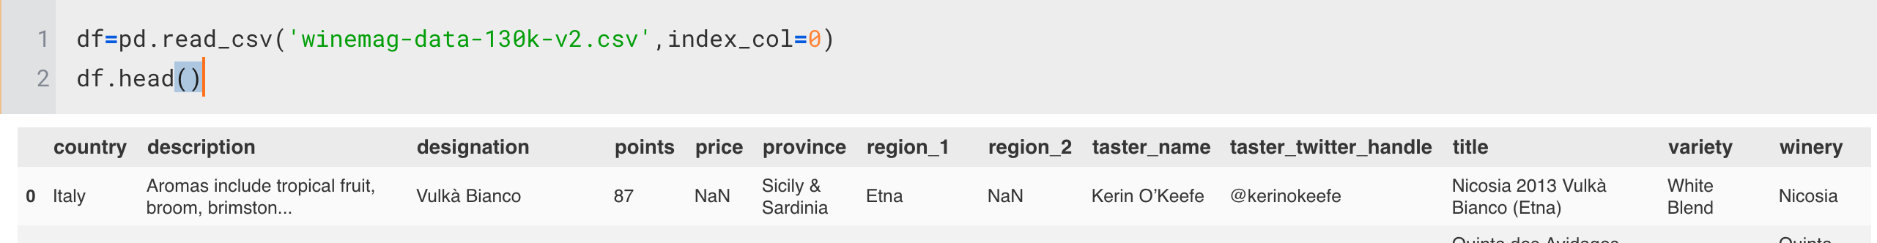
Our Dataset
130 K records from a CSV file from Kaggle
Key Variables
Location: Country, Provinces
sub regions: county-levels
Price of wines
wine taster reviewing scores
wine description
tasters’ twitter account
winery names

Slide 4
What questions are we exploring
What’s the top influential factors on wine prices? (Including Region? Weather? Sentiment? Reviewing scores?
What’s the correlation between review point and wine tasters’ twitter account popularity/ account sentiment?
Other relationship

Slide 5
How do we prepare
Twitter API
Open Weather API
Sentiment Analysis Lib
Geo Location Libraries
Wine Data

Slide 6
What do we find out?

Slide 7
Demographic Relationship

Slide 8
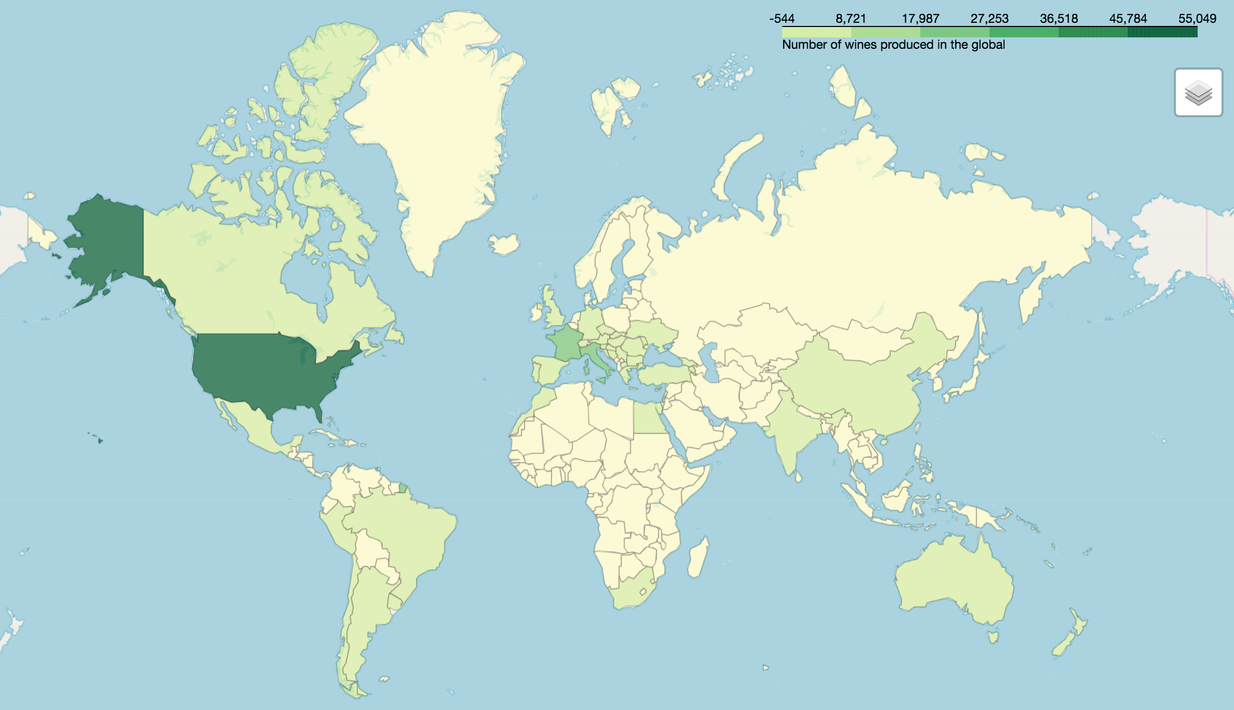
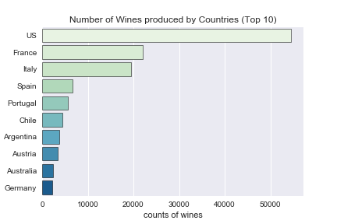
Which country produces the most number of wines?
United States, 43.7%

Slide 9
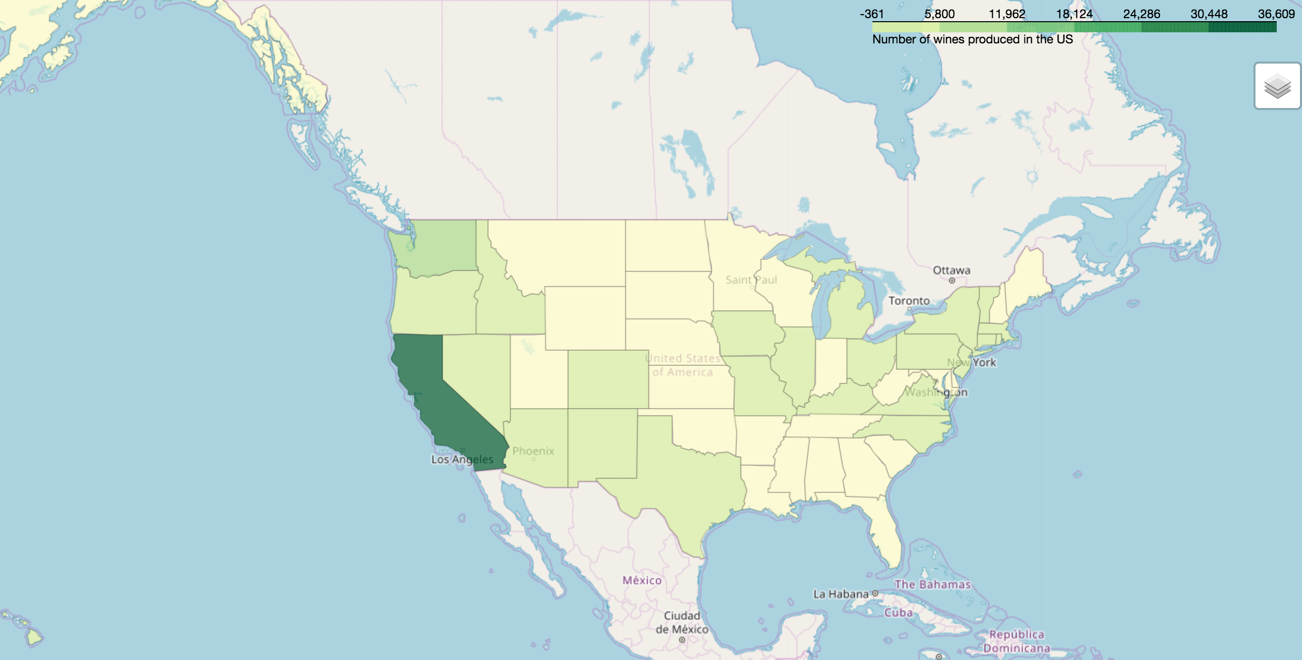
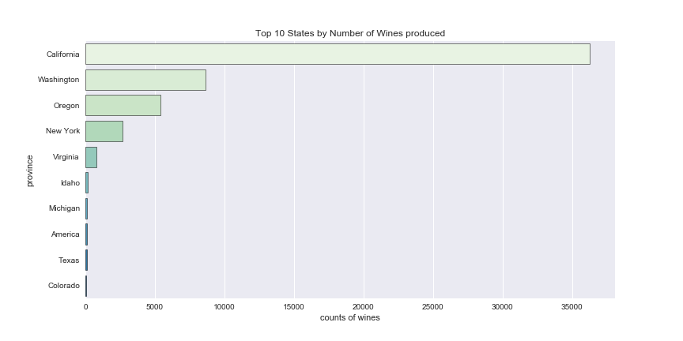
Which state is the winner in producing wines in US?
California, 67%

Slide 10
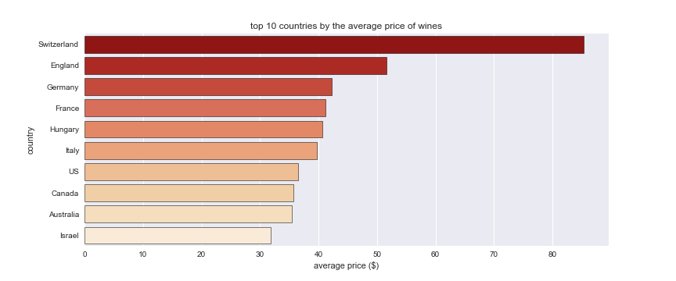
Which country produces the most expensive wines?
Switzerland, $ 85.3

Slide 11
Does weather affects wine prices?

Slide 12
climate, weather and soil are the major contributors to wine production after a couple of Google searches.

Slide 13
With available sources:
Wine data from Kaggle: Price, City
OpenWeather API: City, Temperature, Humidity
The question we could answer is the effects of Temperature and Humidity on the price of wine.

Slide 14
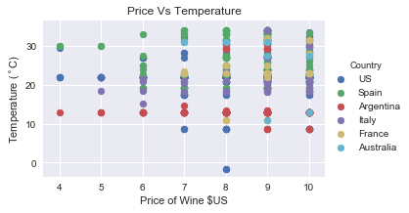
Temperature VS. Price of the least expensive wines

Slide 15
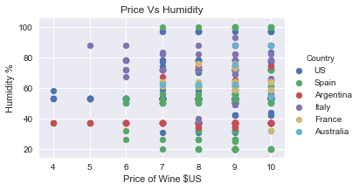
Humidity VS. Price of least expensive wines

Slide 16
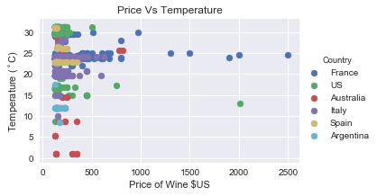
Temperature vs Price of most expensive wines

Slide 17
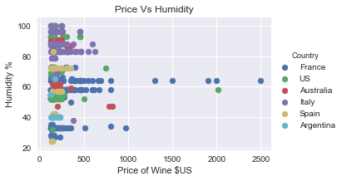
Humidity vs Price most expensive wines

Slide 18
Convergence seems to be key here. Let's narrow down to province to try and find if this is consistent.

Slide 19
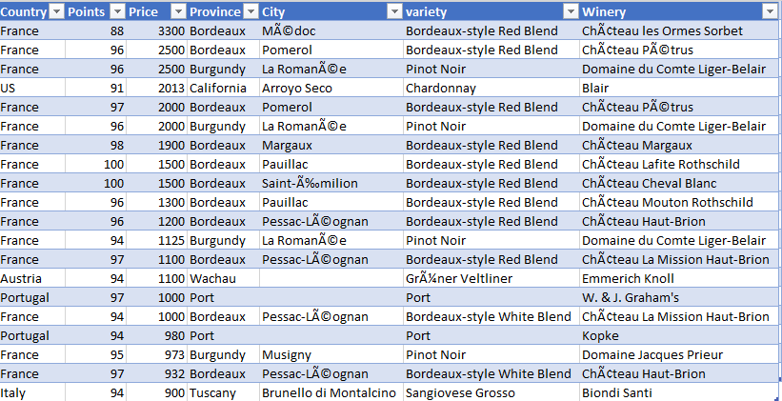
Top 20 most expensive wines

Slide 20
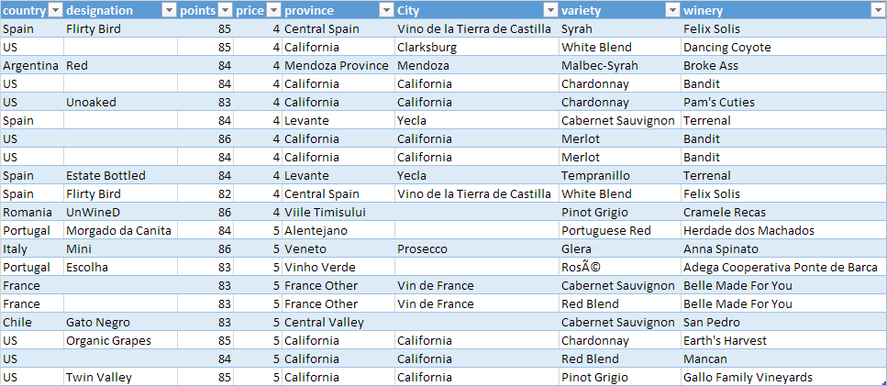
Least ExpensiveWines：

Slide 21
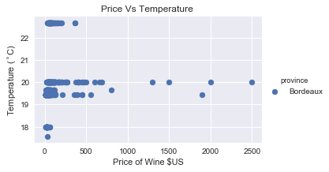
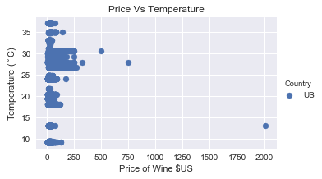
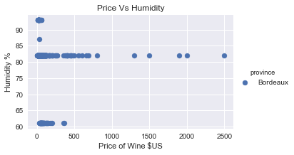
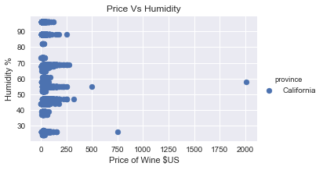
California and Bordeaux Analysis

Slide 22
The graphs seem to show a consistency of weather affecting the price of wine!!

Slide 23
Sentiment Analysis

Slide 24
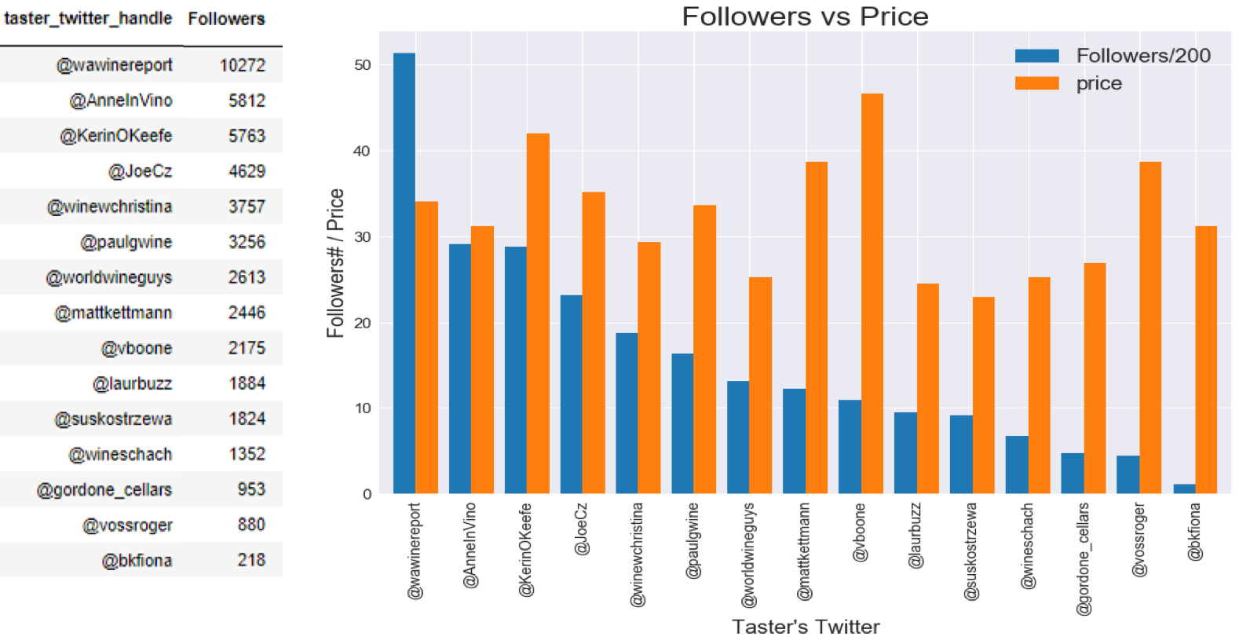
Finding 1: Wines reviewed by popular tasters don’t necessarily have Higher mean Higher Price

Slide 25
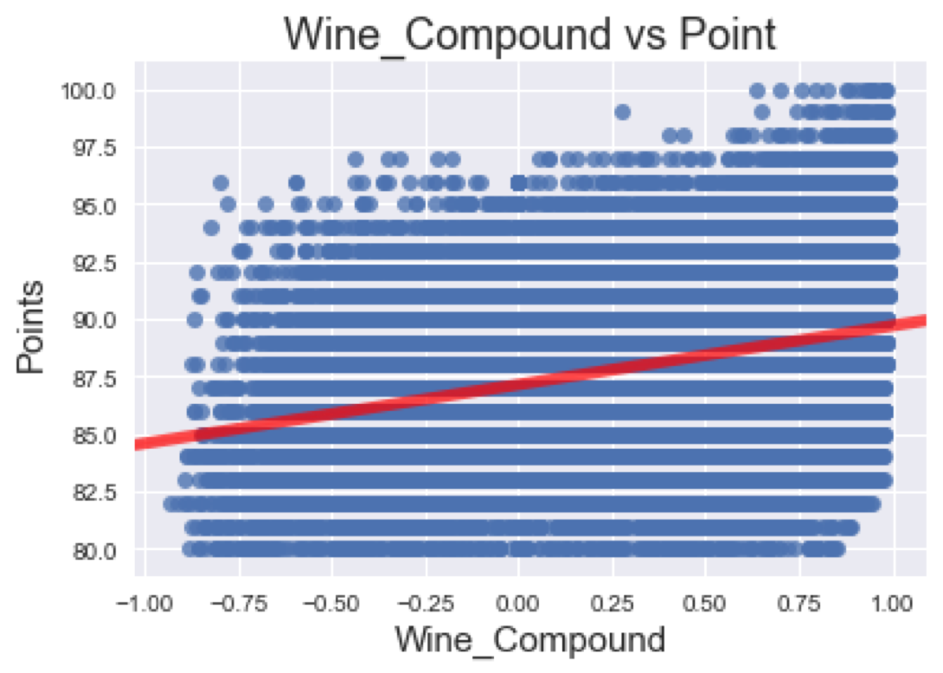
Finding 2: There is POSITIVE correlation between the wine descriptions and review scores.

Slide 26
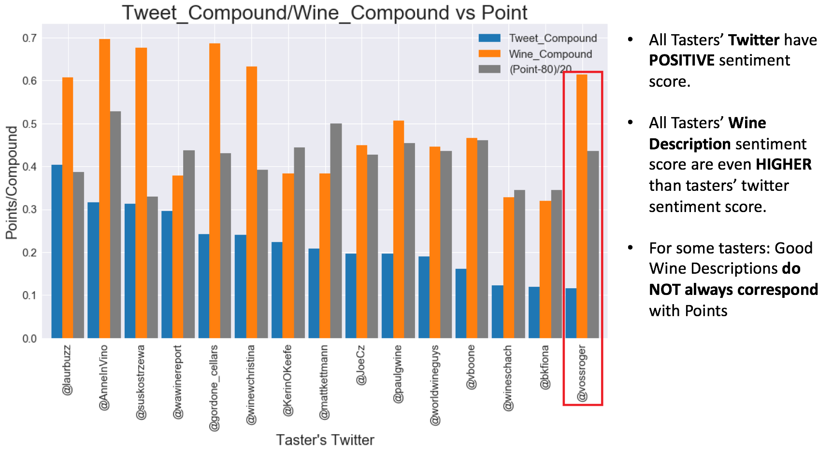

Slide 27
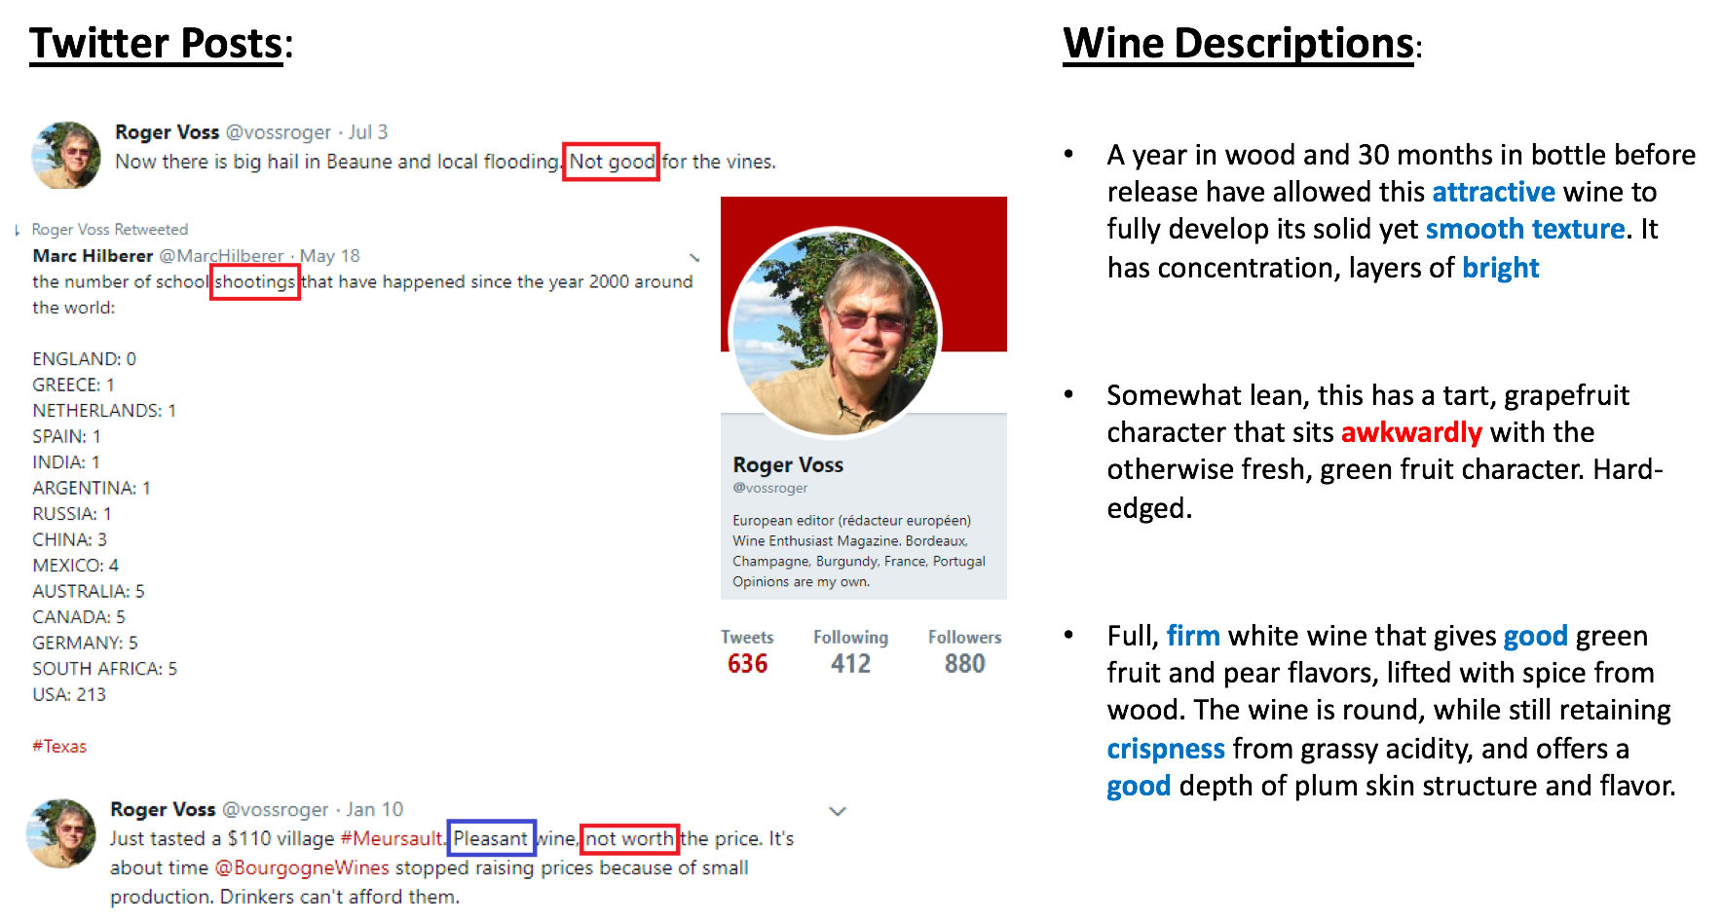
Sentiment Analysis on Tasters’ Twitters and Wine Descriptions

Slide 28
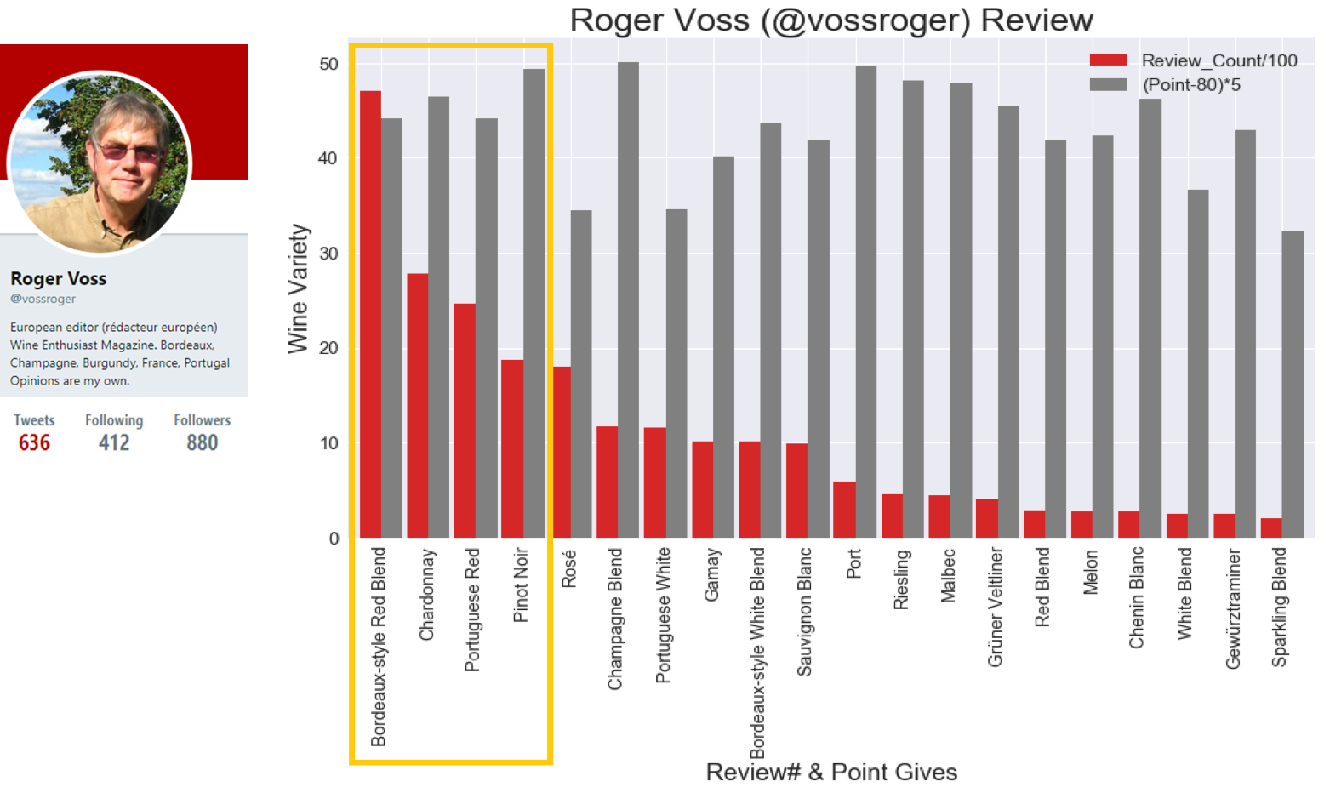
Wine Types vs. Reviews

Slide 29
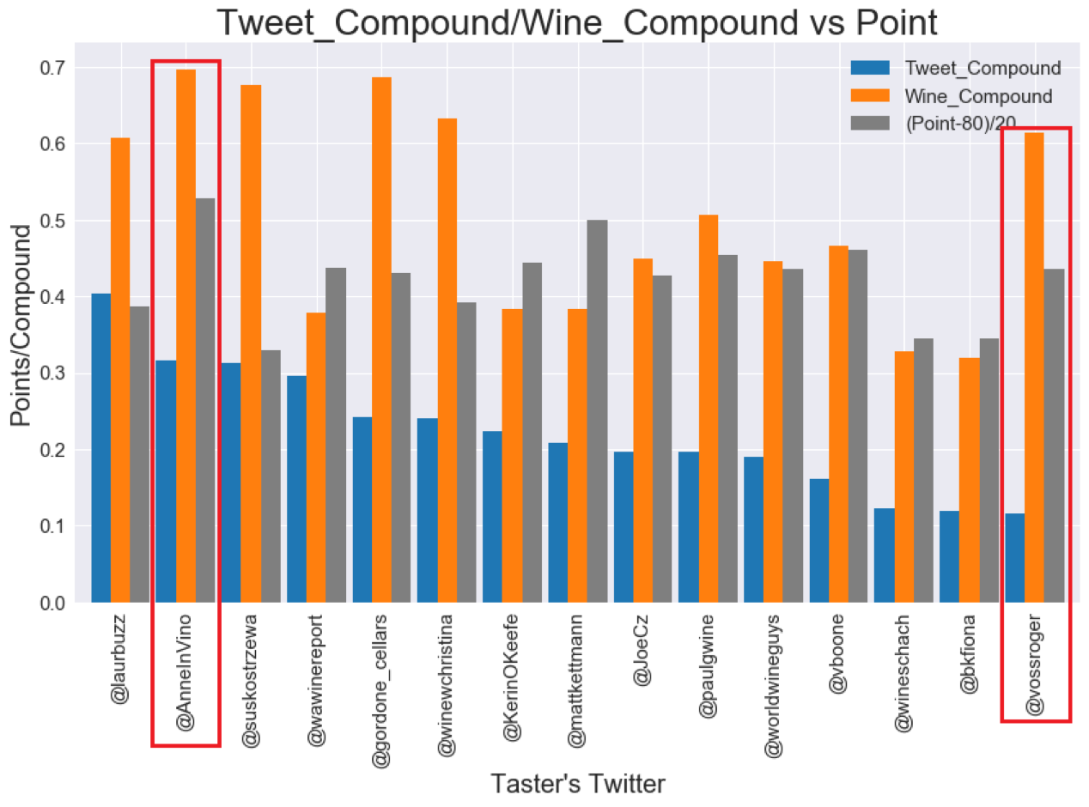
Who else will be a better taster, if chosen by winery?
•Very Positive Wine Sentiment Score
•High Wine Review Point
•Large Twitter Follower Base

Slide 30
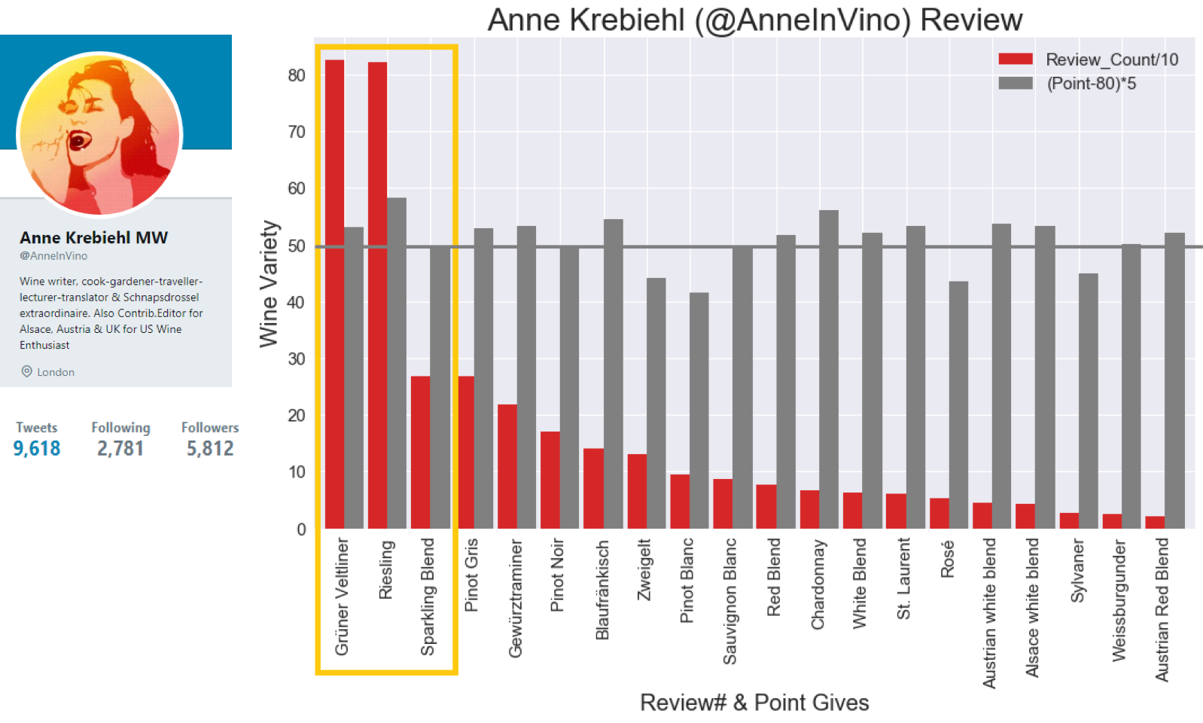

Slide 31
Next Chapter

Slide 32
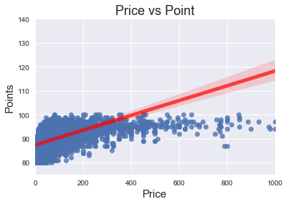
Review Scores VS Price

Slide 33
Wine Type vs Price

Slide 34
Wineries vs Price

Slide 35
Wineries vs Review Scores

Slide 36
Wine Types vs Review Scores

Slide 37
Conclusions
Most of wines in our dataset are from United States and so are the least expensive. Most expensive are from France. There is more weather variation in US vineyards than there is in French vineyards.
Temperature of 20-30 degrees celsius the is most suitable to produce high-priced wines
Certain types of wines are reviewed most by tasters (pinot noir, chardonnay)
Positive Correlation between Wine Description and Review Scores
Tasters’ tend to give more positive Wine Descriptions than personal Twitter posts.

Slide 38
Limits and Difficulties
We could have used more informative API's to answer other key factors to production of wine but they cost money, lots of money.
The weather is based on current weather; we could not acquire historical weather information.
The names of some of the cities in the CSV French cities use special characters which are not recognized by the OpenWeather API JSON eg La RomanÃ©e.

Slide 39

QA

